Slide 1
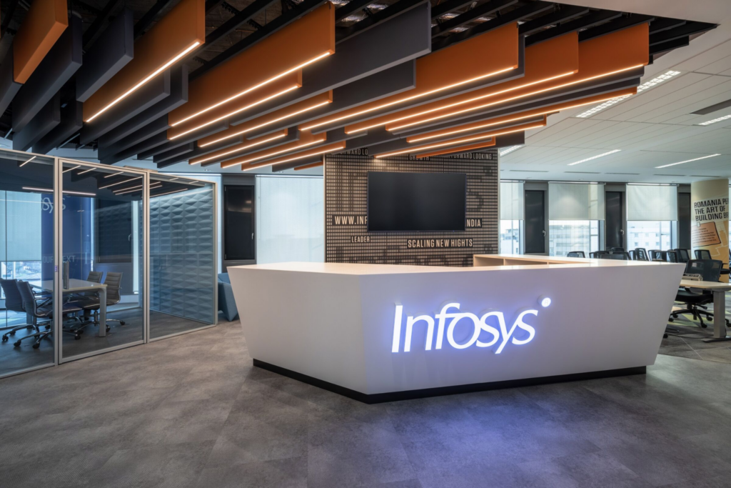


MRI-BASED AI SCAN FOR BREAST CANCER DETECTION
G. Rebekah Rose
AI/ML Project Intern
07/09/2024 to 02/12/2024

Slide 2


ABOUT MYSELF
Educational Background:
Pursuing a Bachelor of Technology (B.Tech) in Computer Science Engineering from Vardhaman College of Engineering.
Skill Set and Technical Expertise:
Proficient in programming languages like Python, Java, and SQL.
Strong foundation in AI, Machine Learning, OpenCV, and Computer Vision.
Experienced in web technologies such as HTML5, CSS3, JavaScript, and Flask.

Slide 3

PROJECT OVERVIEW
Objective:
Develop an image classification system to distinguish between benign and malignant breast tumours using deep learning techniques.
Tasks and Methodologies
Implemented ResNet18, a convolutional neural network, for tumour classification using MRI breast cancer images.
Preprocessed data with resizing, normalisation, and augmentation techniques like random flips and rotations to enhance model generalisation.
Extracted image features using advanced methods like local binary pattern (LBP) and histogram of orientated gradients (HOG).
Key Contributions
Achieved a training accuracy of 97.86% and a validation accuracy of 84.92%, demonstrating the system's potential for assisting radiologists in diagnosis.
Documented challenges and explored solutions like data augmentation and transfer learning for improving model performance.
Tools Used
Python, PyTorch, OpenCV, and libraries like NumPy and scikit-image for feature extraction and model training.

Slide 4

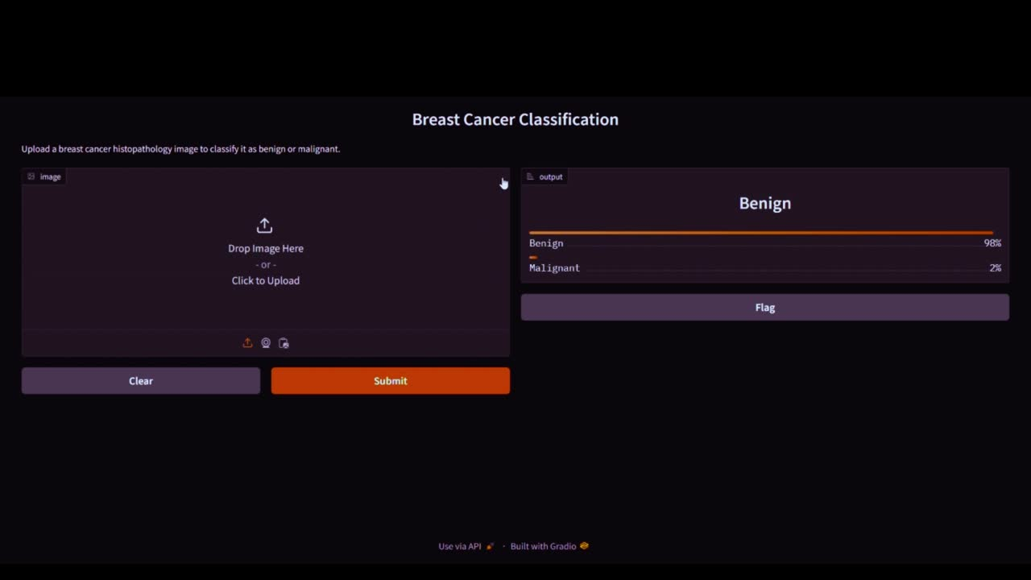
DEMO

Slide 5

ACHIEVEMENTS
Major Milestones
Successfully implemented the ResNet18 CNN architecture for classifying MRI images into benign and malignant tumors.
Developed a robust preprocessing pipeline using resizing, normalization, and data augmentation to enhance model performance.
Applied advanced feature extraction techniques like Local binary Pattern (LBP) and histogram of Oriented Gradients (HOG) for detailed image analysis.
Results and Impact
Achieved:
Training Accuracy: 97.86%
Validation Accuracy: 84.92%
Demonstrated the potential of deep learning in assisting radiologists with faster and more accurate tumour classification.
Identified areas for improvement, such as exploring transfer learning and fine-tuning hyperparameters, for future research.

Slide 6

LEARNINGS
Technical Skills Gained
Deep Learning: Developed expertise in implementing and fine-tuning CNN architectures like ResNet18.
Feature Extraction: Hands-on experience with advanced techniques like Local Binary Pattern (LBP) and Histogram of Oriented Gradients (HOG).
Data Preprocessing: Learned to apply resizing, normalization, and augmentation techniques to improve model generalization.
Tools and Frameworks: Proficient in Python, PyTorch, OpenCV, and libraries like NumPy and scikit-image.
Model Evaluation: Gained knowledge in interpreting metrics such as accuracy, AUC, and confusion matrices to assess model performance.

Slide 7
LEARNINGS
Soft Skills Improved
Problem-Solving: Tackled challenges like overfitting and dataset variability with innovative solutions such as data augmentation and early stopping.
Collaboration: Worked effectively within a team environment, sharing insights and feedback with peers and mentors.
Time Management: Balanced multiple project components, meeting deadlines efficiently.
Communication: Improved technical documentation and presentation skills by articulating findings and results clearly to stakeholders.

Slide 8

Q&A

Slide 9

THANK YOU
FOR YOUR ATTENTION

